Slide 1
Using Ambari to Manage Applications
Ali Zaidi
Data Scientist
Machine Learning Education Team

Slide 2

Monitoring and Managing Hadoop with Ambari Web UI

Slide 3
Apache Ambari: What is it?
A 100% open source framework for provisioning, managing and monitoring Apache Hadoop clusters
Systems Administrators | Provisioning | Provides step-by-step wizard for installing Hadoop services across any number of hosts
 |  | Handles configuration of Hadoop services for the cluster
 | Managing | Provides central management for starting, stopping, and reconfiguring Hadoop services across the entire cluster
 | Monitoring | Provides dashboard for monitoring health and status of the Hadoop cluster
 |  | Leverages Ambari Metrics System for metrics collection
 |  | Leverages Ambari Alert Framework for system alerting and will notify you when your attention is needed (e.g., a node goes down, remaining disk space is low, etc)
Application Developers and System Integrators | Can easily integrate Hadoop provisioning, management, and monitoring capabilities to their own applications with the Ambari REST APIs.

Slide 4
Ambari: Management Features Overview
Interactive Wizard Driven cluster Installation
Non-interactive API-driven cluster installation
Granular control of cluster services start up and shut down
Cluster service configuration management
Dashboard cluster monitoring with alerts
REST API for integration with other vendors
Ambari Views for custom plug-in

Slide 5

Apache Ambari: Architecture Overview
View
View
View
plugins
Ambari Web UI
REST API
Ambari Server
Ambari Agent
Ambari Agent
Ambari Agent
Ambari Agent
Ambari Agent
Worker Node
Worker Node
Worker Node
Worker Node
Worker Node

Slide 6
Managing HDInsight with Amabari

Slide 7
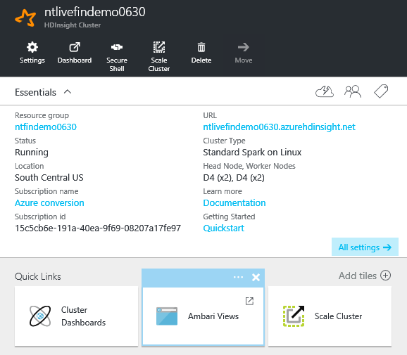
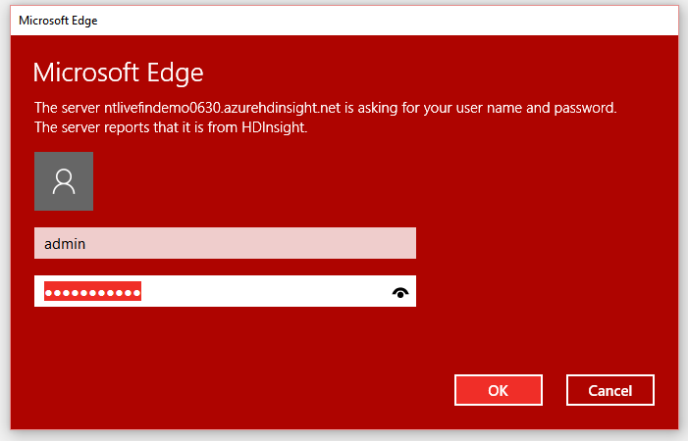
HDInsight and Ambari
The Ambari Web UI can be launched directly from the Azure HDInsight Portal

Slide 8
Ambari Web UI Dashboard

Slide 9
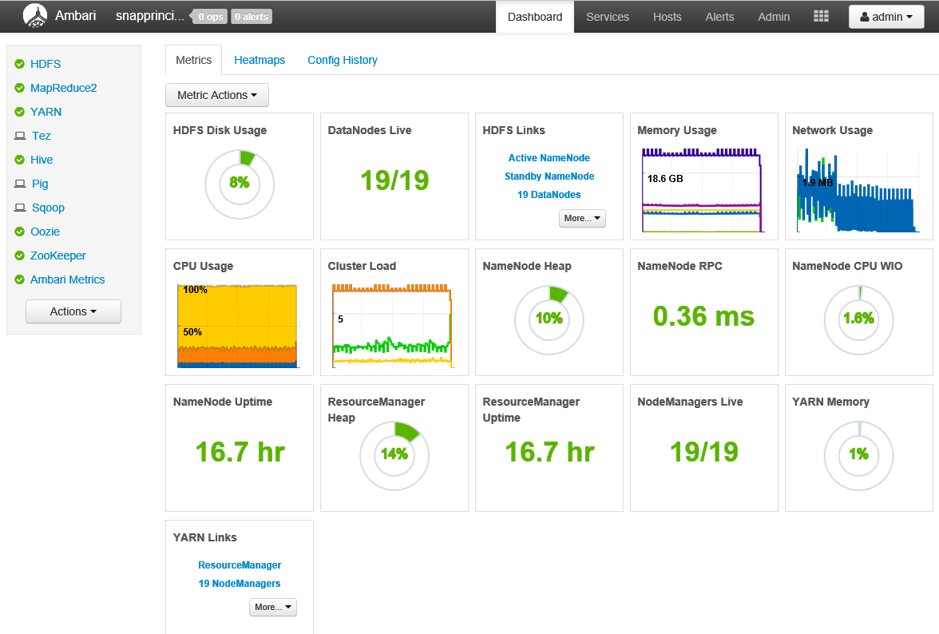
Ambari Web UI: Dashboard Metrics
The Metrics tab of the Dashboard page displays cluster-level system metrics including:
CPU Usage
HDFS Disk Usage
Memory Usage
Network Usage
…
Dashboard enables you to understand the state of the cluster at-a-glance.
The dashboard look can be customized by adding and removing Widgets
The list of installed services always appears in the left-side panel.
The Actions Menu button lets you start, stop or restart an entire cluster.

Slide 10
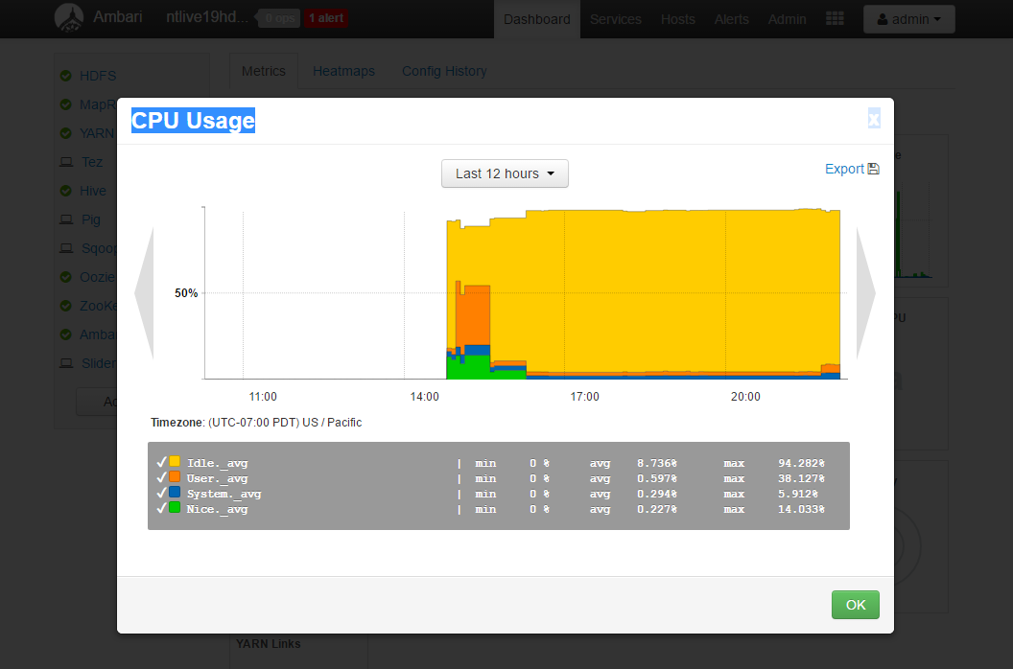
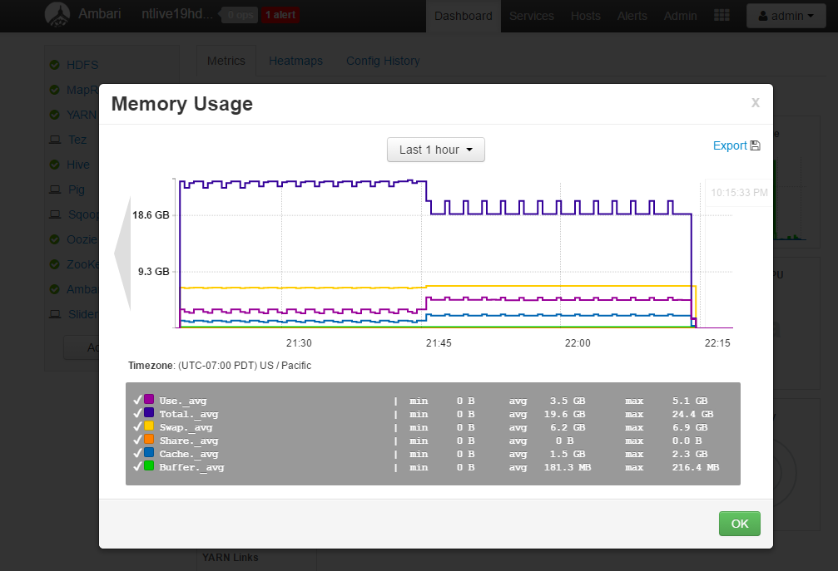
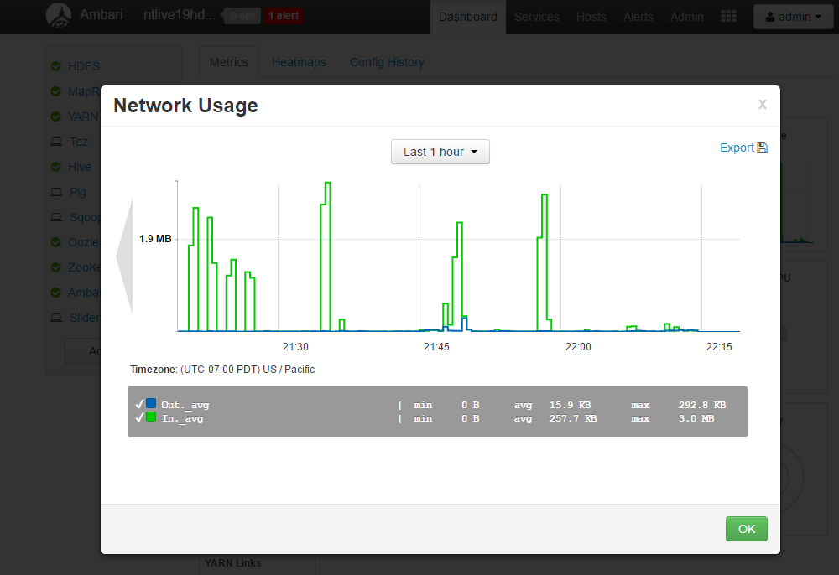
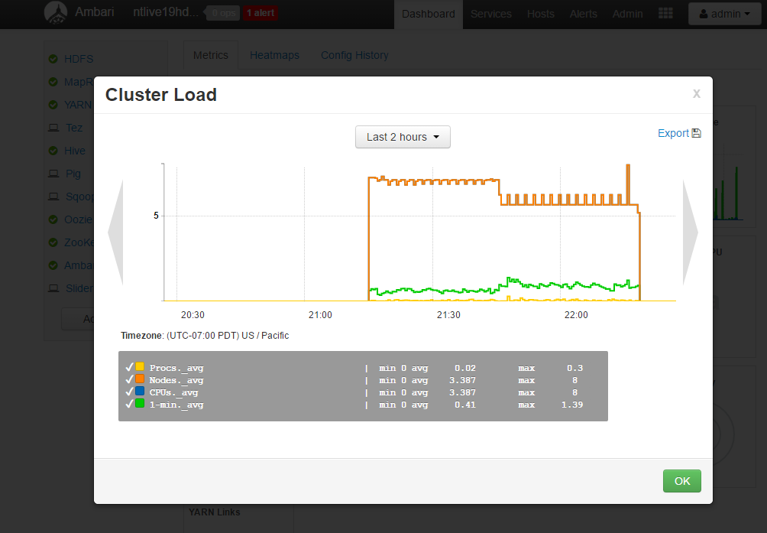
Ambari: Dashboard Metrics Drilldown
You can drilldown to get more details on
CPU Usage
Cluster Load
Network Usage
Memory Usage
The usage stats can be viewed over any custom period.
For other metrics you see additional info by hovering over the Widget.

Slide 11
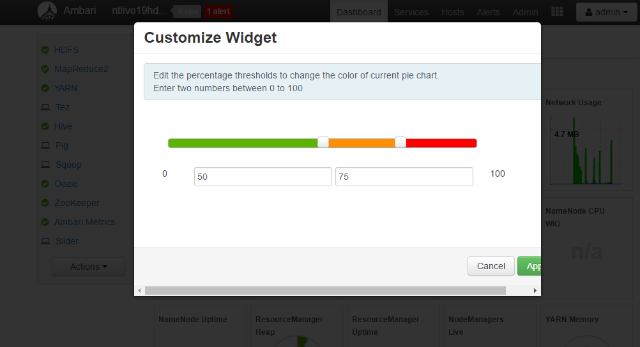
Ambari: Dashboard Widget Customization
For these Widgets:
YARN Memory
Node Managers
Resource Managers
NameNode CPU
NameNode RPC
NameNode Heap
The color can be customized by configuring the % thresholds

Slide 12
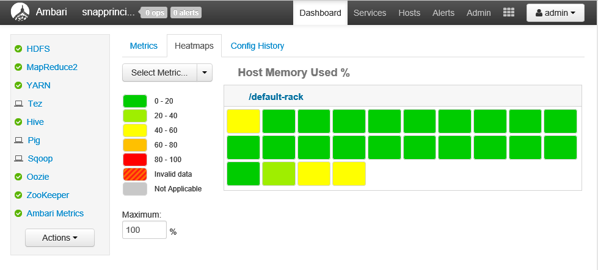
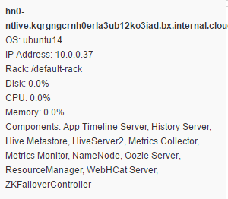
Ambari Dashboard: HeatMap
The Dashboard Heatmap view provides a color-coded view of each of the nodes in the cluster for selected metrics.
Hovering over each of the nodes pops ups additional information

Slide 13
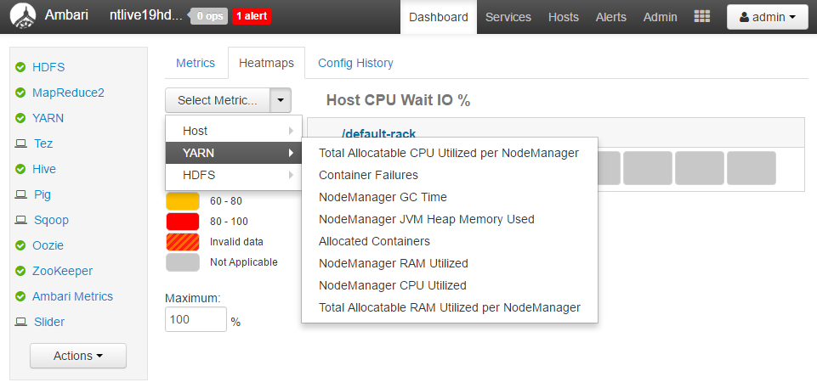
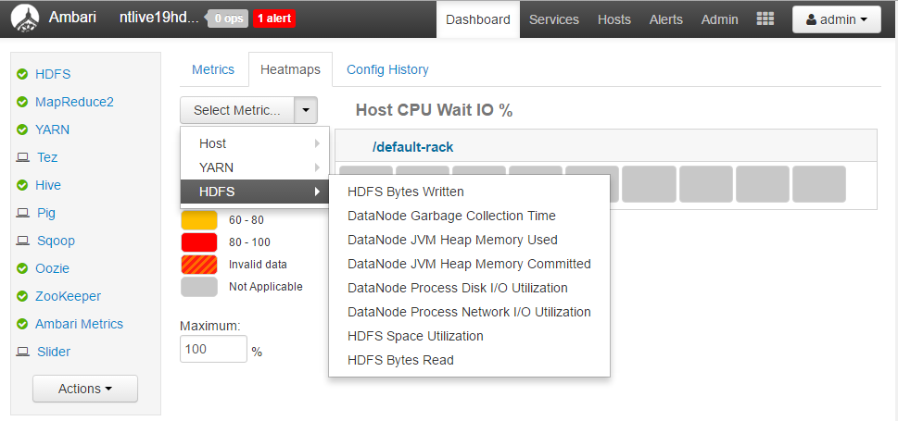
Ambari Dashboard: HeatMap
You can choose to show the Heatmap for ‘Host’, ‘Yarn’ and ‘HDFS’.
Each has an number of associated metrics for which the heatmap can be displayed.

Slide 14
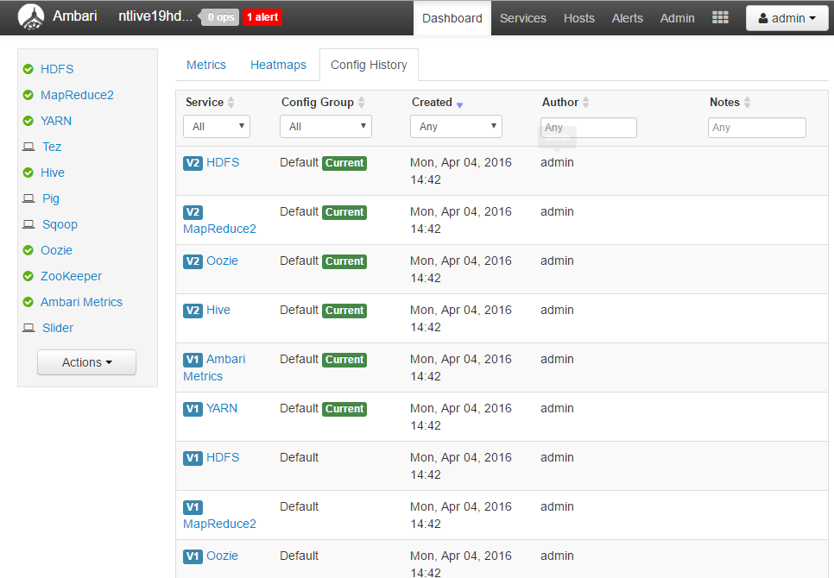
Ambari Dashboard: ‘Config History’
The Dashboard ‘Config History’ view displays the list of the configuration changes made, along with ‘when’ and ‘who’ details.
Additional config history details can be seen by drilling down into the specific services—this can also be seen from the ‘Services’ view or by clicking on the Services links on the left of the page

Slide 15
Ambari UI: Alerts

Slide 16
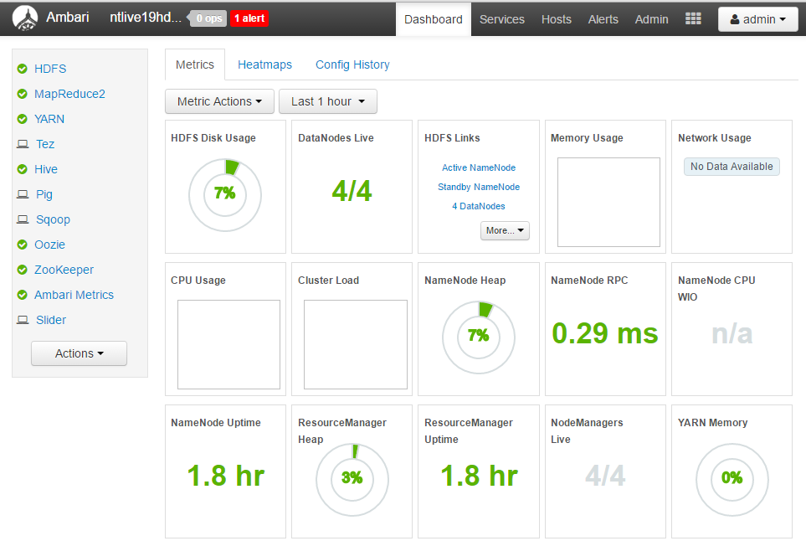
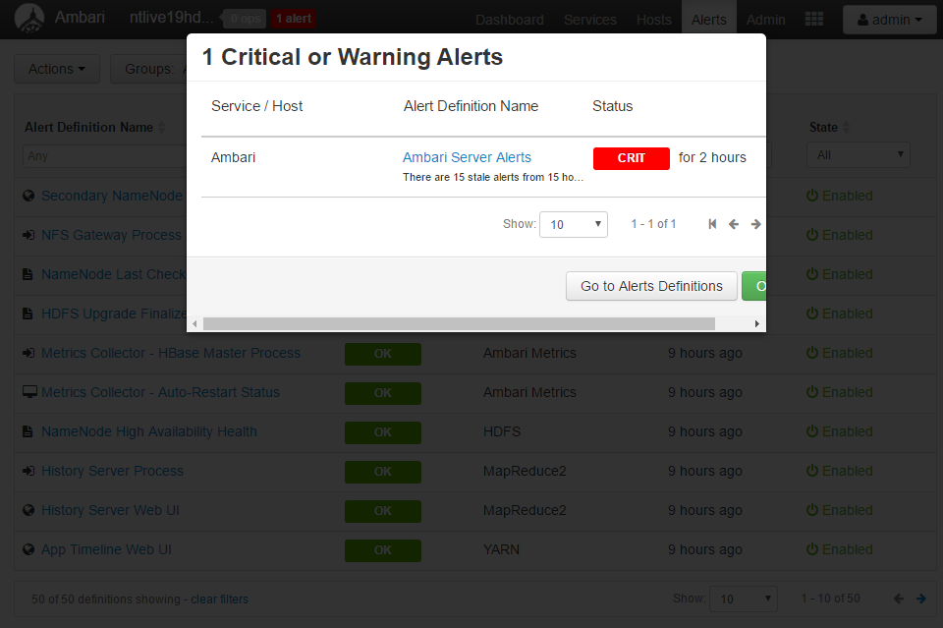
Ambari UI: Alerts
Ambari Web UI display any critical or Warning alerts at the top the page.
Clicking on the alert, pops up the list of alerts and current status
Clicking on ‘Go to Alerts’ definition display the complete list of alerts

Slide 17
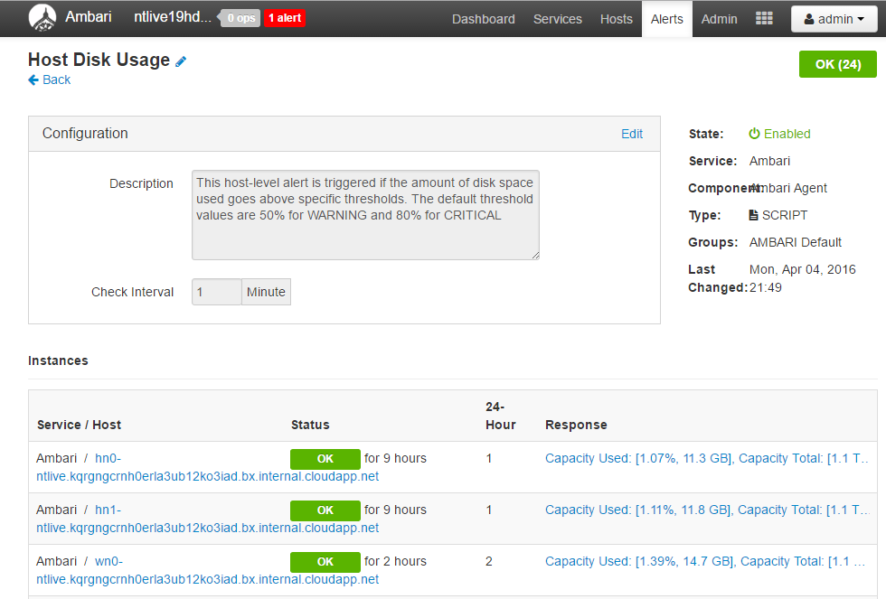
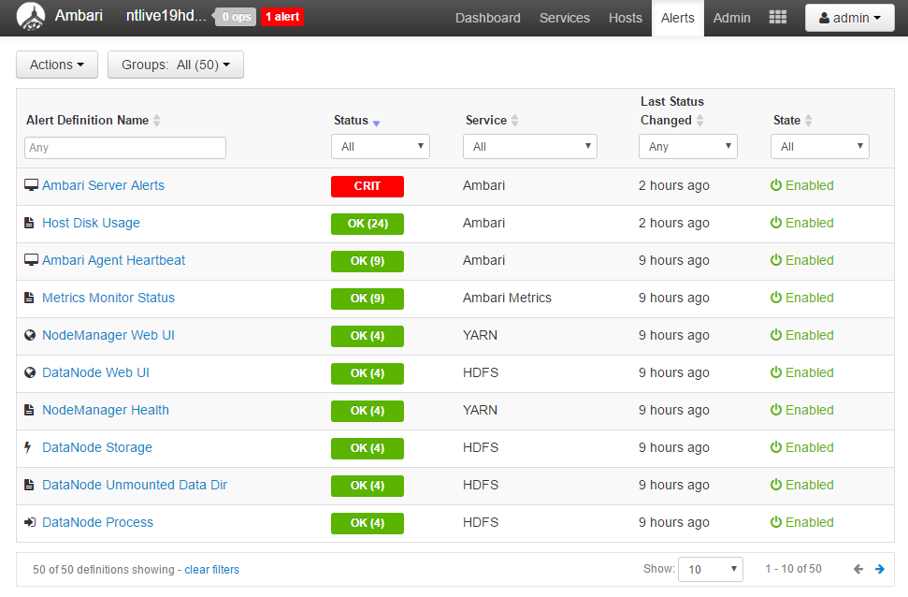
Ambari: List of Alerts
Ambari alerts are classified as:
Critical
OK
Unknown
None
You can drill down into specific alerts for details.
You can set the ‘Check Interval’ for the alerts by editing the alert.

Slide 18
Ambari UI: Services

Slide 19
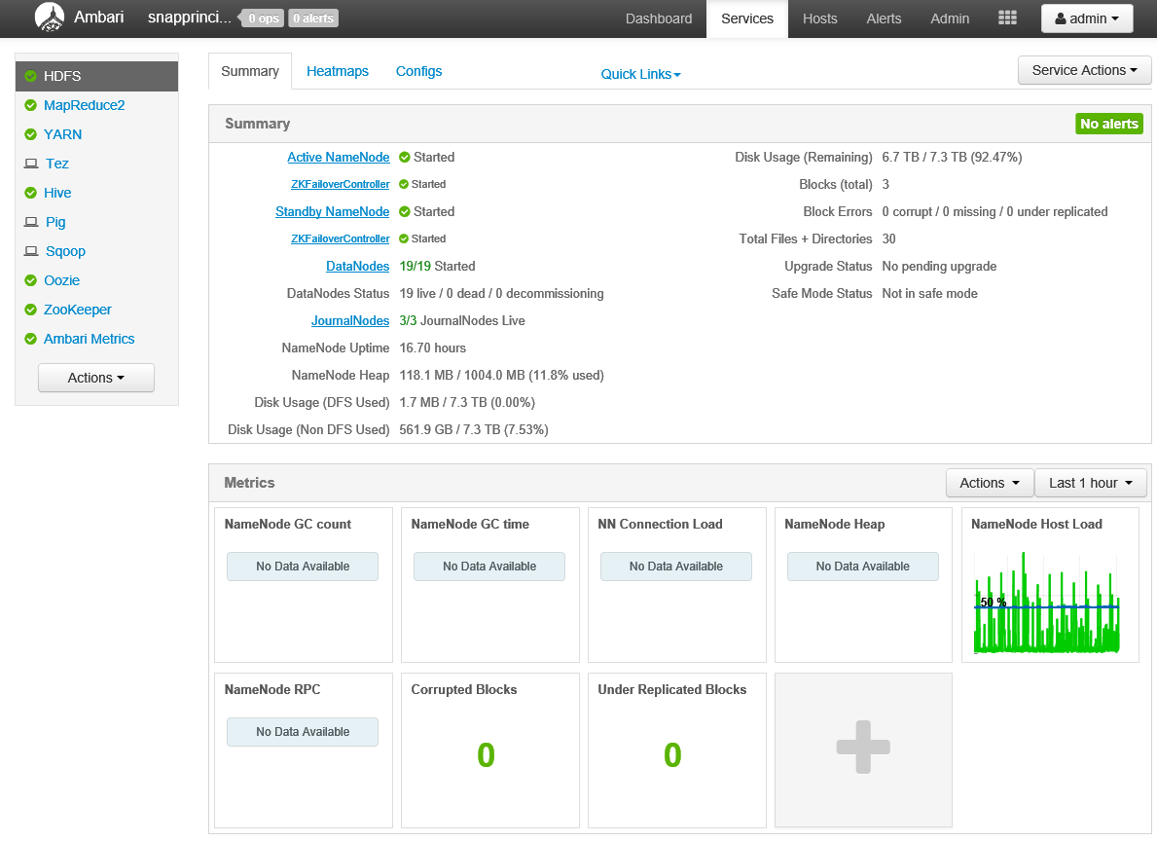
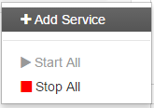
Ambari Web UI: Services
The Services page provides quick insights into the status of the services running on the cluster.
In this case the list of services running on the cluster include: HDFS, MapReduce2, YARN, Hive, Oozie and Zookeeper
Icons indicate status or actions that should be taken.
Shown here the details for HDFS for the last 1 hour.
You can Start or Stop all services

Slide 20
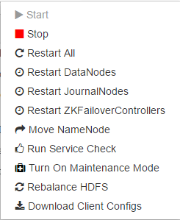
Ambari Web UI: Service Actions
For each service there are a list of associated “Service Actions” to manage, monitor and configure the service.
As the Service Actions menu button is context-sensitive, the menu choices are different for each service.
The Service Actions for HDFS are shown here.
Maintenance Mode should be enabled when making cluster hardware or software changes. It suppresses Ambari alerts, warnings and status change indicators
Notes:
The Actions menu button is where you would start, stop, or restart an entire cluster. You can install additional services using the Actions menu button. For example, Falcon is not installed on this cluster and could be added using the Actions menu button.
Maintenance Mode should be enabled when making cluster hardware or software changes. For example, Maintenance Mode is useful when changing a service configuration, shutting down a cluster node, removing a cluster node, or even during troubleshooting sessions. Explicitly turning on Maintenance Mode for a service implicitly turns on Maintenance Mode for components or hosts that run the service.
Maintenance Mode suppresses Ambari alerts, warnings, and status change indicators. It also exempts an object from host-level or service-level bulk operations. For example, if HDFS DataNode 8 were shut down for maintenance, Ambari would generate alerts and warning messages about that DataNode’s “failure”. Enabling Maintenance Mode on the DataNode prior to shutting it down would prevent this behavior. As another example, if DataNodes 11 and 12 are placed in Maintenance Mode, then they would be exempt from the bulk Restart All or Restart DataNodes actions on the Ambari HDFS Service Actions menu button.
While Maintenance Mode prevents bulk operations, an Ambari user may still use Ambari to explicitly start and stop a specific service, service component, or host in Maintenance Mode.

Slide 21
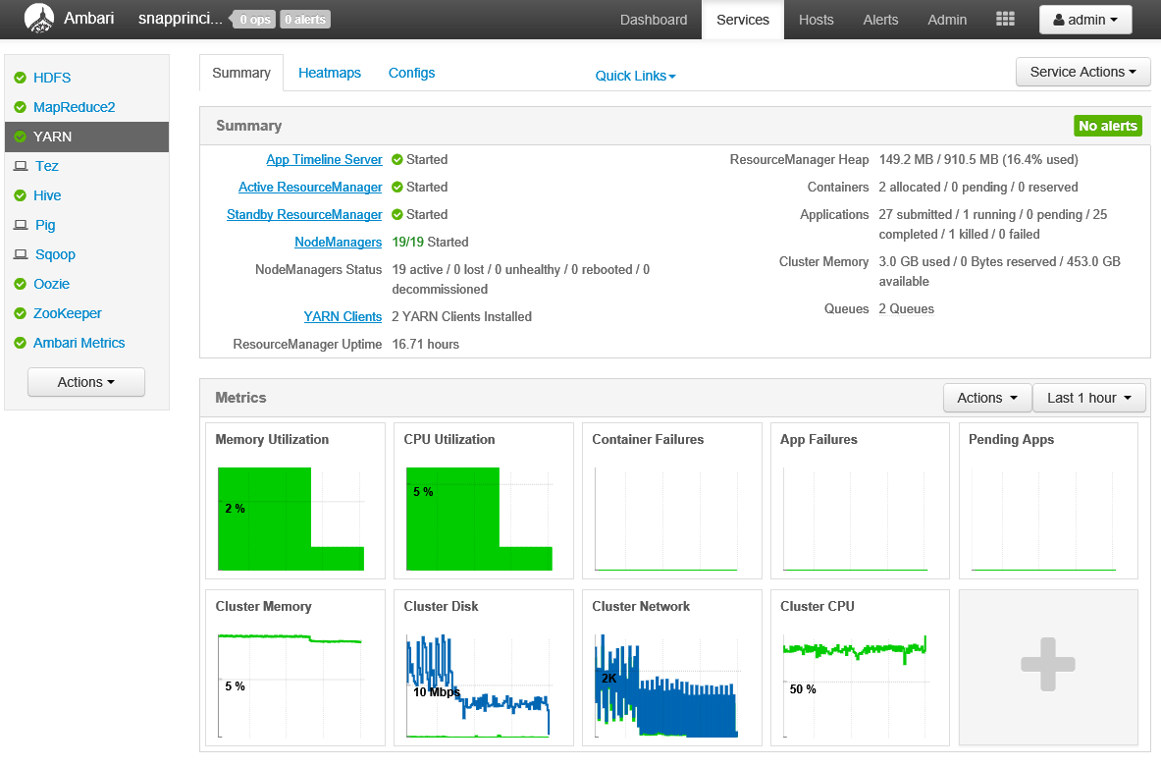
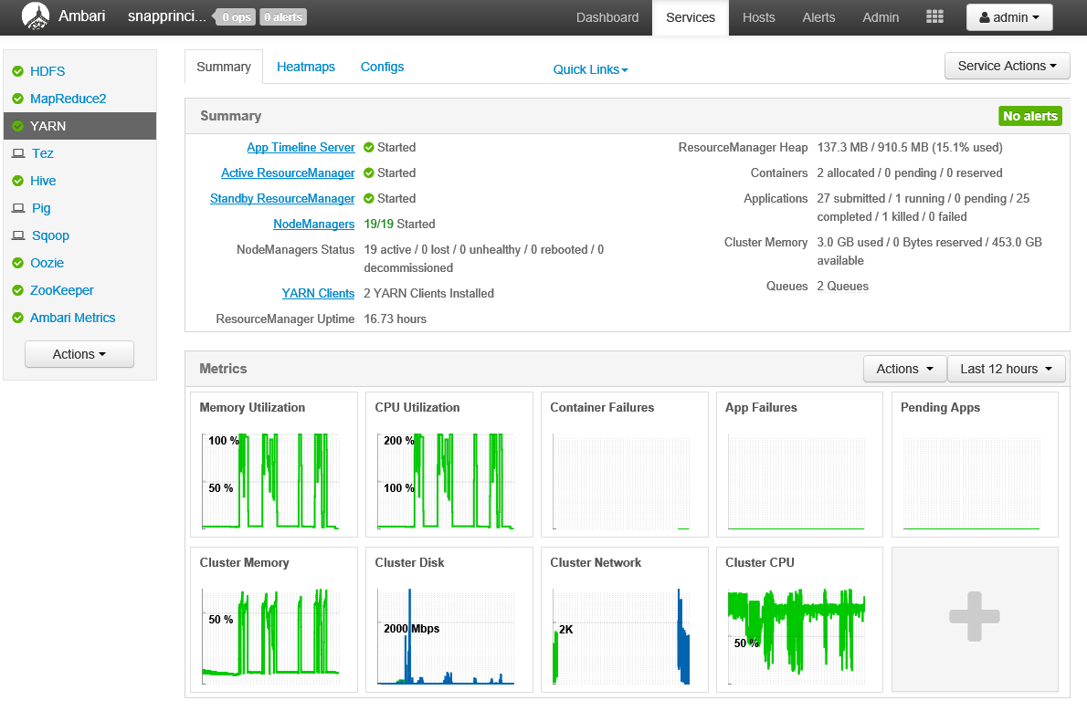
Ambari Web UI: Services (YARN)
The Services page details for YARN for the last 1 hour
… and the last 12 hours

Slide 22
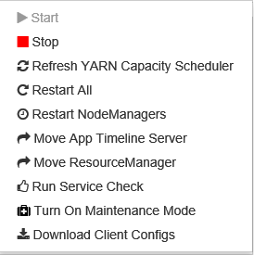
Ambari: YARN “Service Actions”
Here are the list of actions that can be taken with YARN.

Slide 23
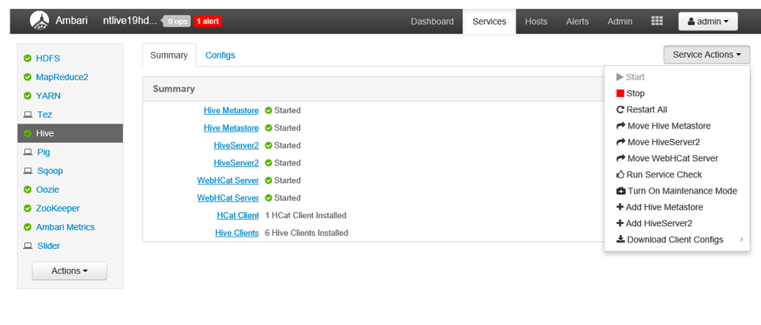
Ambari Web UI: Hive Service Actions
This is the Hive Services page with the list of associated actions.

Slide 24
Ambari Web UI: Hosts

Slide 25
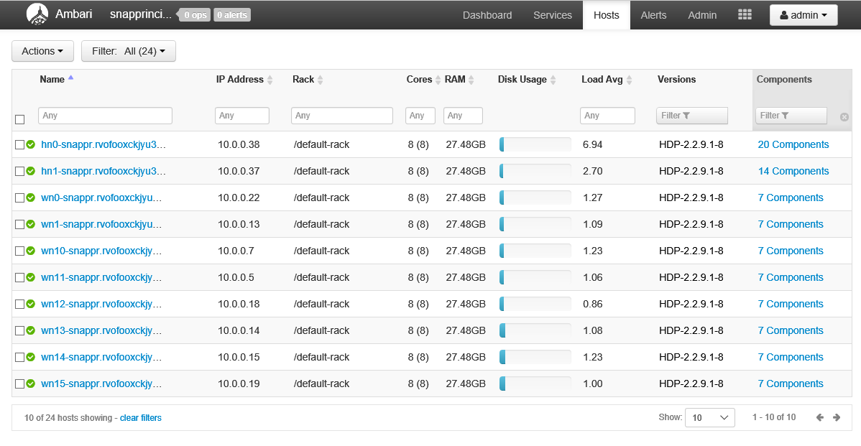
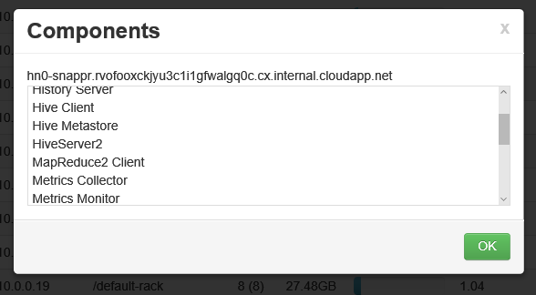
Ambari Web UI: Hosts
The Hosts page provides system-level metrics for each node in the cluster including.
Clicking on the components link, provides more details on the list of components running on the node.

Slide 26
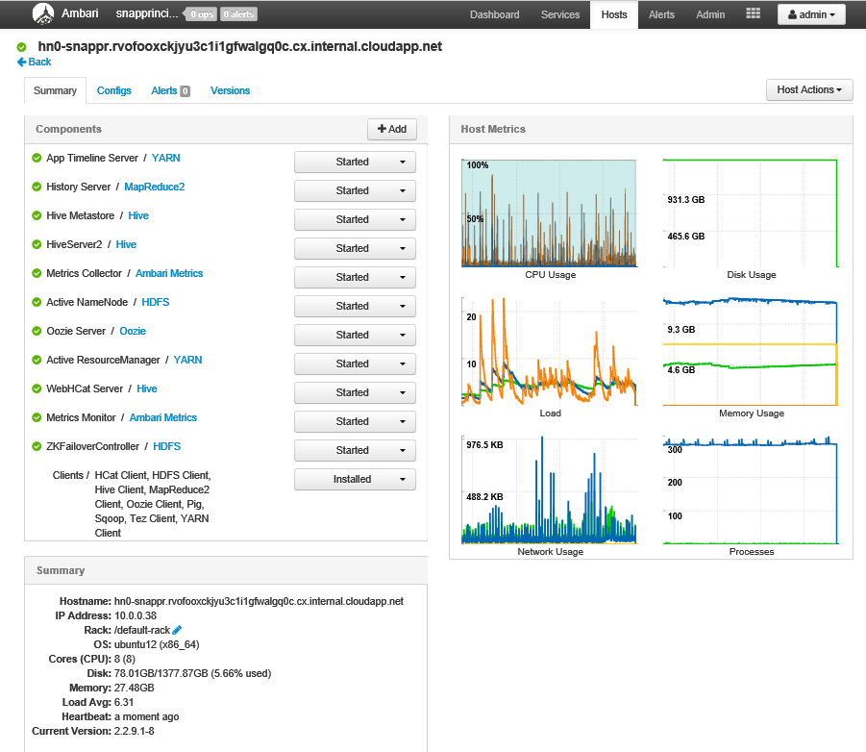
Amber Web UI: Hosts Drilldown
You can drilldown into the details of any of the nodes in the cluster.
At a glance you can see the charts for CPU, Memory and Network usage.
The summary system-configuration information is also displayed.
You can see—and change—the status of each of the components running on the node.

Slide 27
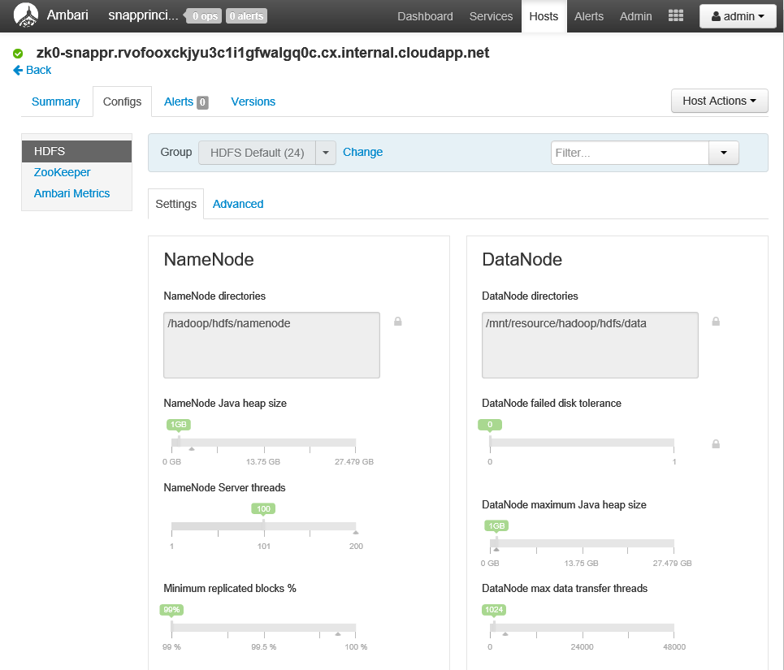
Ambari Web UI: Host Component Drilldown
On the hosts page you can drill down into the details about any of the components running on the node.
This shows key metrics about the HDFS component running on the this node.
You can configure HDFS parameters such as:
NameNode Java heap size
NameNode Server threads
Minimum replicated blocks %
DataNode failed disk tolerance
DataNode max Java heap size
DataNode max data transfer threads

Slide 28
Ambari Web UI: User Views

Slide 29
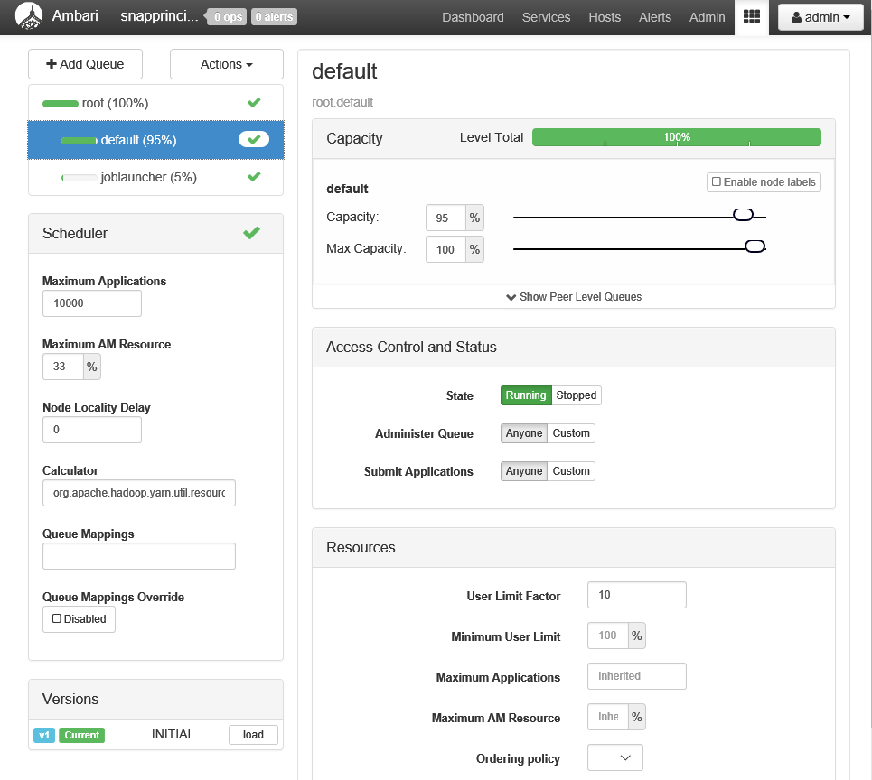
Ambari: Capacity Scheduler View
The YARN Capacity Scheduler allows Hadoop to be shared among multiple independent tenants while providing guaranteed capacity and predictable SLAs.
The Capacity Scheduler divides resources through use of YARN queues, which are sized based on the relative allocations given to various tenants.
The Capacity Scheduler View lets you create and modify YARN queues and see their distribution at-a-glance.
The UI enforces configuration rules, highlights invalid conditions.
With the Capacity Scheduler View you can:
Partition Hadoop resources among tenants.
Define, view and modify queue definitions.
Establish fine-grained control on who can run jobs in queues.

Slide 30
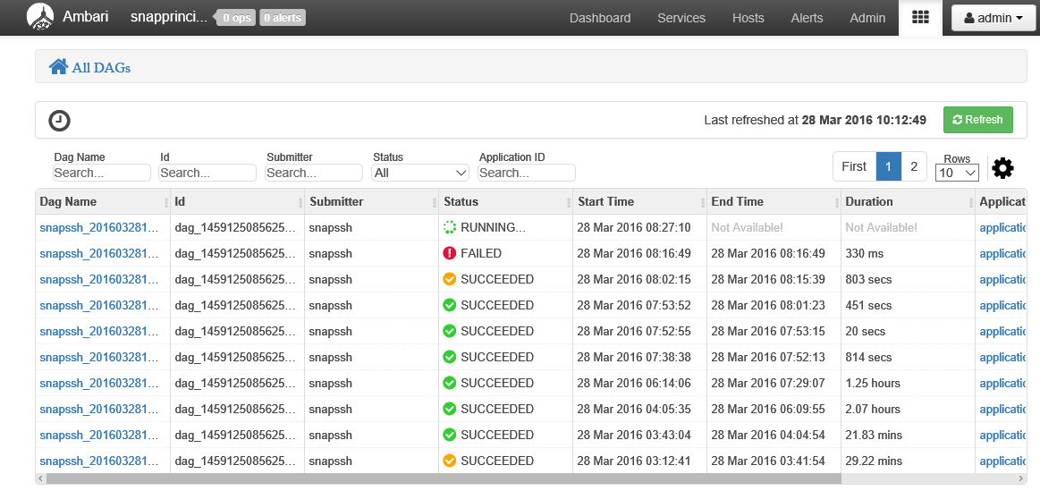
Ambari: Tez View
The Tez View lists all the DAGs (currently executing and historical) over a time period.
You can drill down into specific DAG to see more details

Slide 31
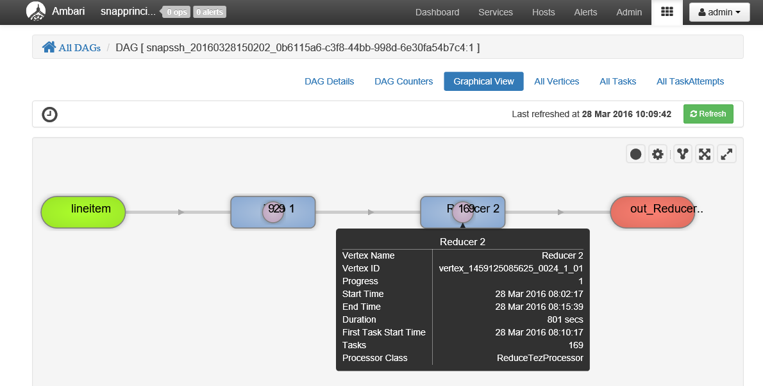
Ambari: Tez View (DAG Details)
The Graphical View lets you visualize the DAG execution flow graphically. You can get move details about any vertex by clicking on it.

